Slide 1
Can Social Cohesion be Harnessed to Repair Market Failures? Evidence from Group Lending in Guatemala: Bruce Wydick
The success of group lending has been attributed to the ability of the institution to mitigate asymmetric information problem in credit markets.
Uses many of the principles from the well-know Grameen Bank model, and operates in the following manner.
  Introduced to small businesses
  Applicants self-select into groups
  Group applies for a single small initial loan
  Loan divided amongst members for investment but all members jointly liable for repayment.

Slide 2
Introduction to Group Lending
Instead of lending directly to individual borrowers, many credit institutions in developing countries have chosen to lend to self-selected group of entrepreneurs
Available to those without access to the formal financial market.
Diversify risk.
All members of group jointly liable for single loan.
Micro-lending – Muhammad Yunus

Slide 3
Why has group lending been so successful?
What role does social cohesion play in group lending’s success?

Slide 4
Besley and Coate (1995)
  Discuss the need for social penalties for default
  Without these sanctions, group loans may as well be individual loans – so the repayment rate will vary
Wydick (1996)
  Group lending deters moral hazard due to social sanctions
  Not based on previous ties, but more on the ability of the group to pressure members in the present with threats of future sanctions

Slide 5
Floro and Yotopolous (1991)
  Argue that previously existing social ties affect repayment/can be used to pressure members
  Because borrowers know group members on a personal level, they feel the pressure to repay simply based on their past relationship (social ties)
  Wydick’s results call this idea into question
Zeller (1998)
  Repayment rates were higher in groups with homogenous demographic/social characteristics (social ties)
  Also called into question by Wydick’s results

Slide 6
Reasons for its Success: Theories
Group formation is determined through self-selection, groups tend to consist of borrowers homogeneous in quality.
This decreases risky borrowers.
Its expected to see better borrowing group performance where social ties between member of borrowing groups are strong.
Strength of group pressure against potential defaulter is a key determinant to group performance.

Slide 7
In Detail, Guatemala - FUNDAP
A loan officer assigned to a specific village introduces local small enterprise owners to the credit program
Loan applicants self-select into groups of 3-8 members
Small loans $200 - $500, paid in monthly installments
Loan jointly divided into group members.
Repayment rate 97%
Defaulters can never participate in the program again

Slide 8
Test
This paper presents a test of the significance of three different types of social cohesion on borrowing group performance.
  Peer Monitoring
  Social ties
  Borrowing Group Pressure

Slide 9
Findings
Peer monitoring appears to be of primary importance in affecting group loan repayment.
Social Pressure is found to have only modest effect and even that is limited to mitigating moral hazard.
Social ties are found to have virtually no significant effect on borrowing group performance.

Slide 10
Summary
Via peer monitoring, borrowing groups appear to function both as miniature insurance networks and as juries, helping those with verifiable claims of hardship to repay loans, while threatening indolent and risky borrowers with expulsion from the group.
Surprisingly social ties are insignificant even tend to create conflict of interest.
Groups enforce repayment more in urban groups then rural.

Slide 11
Guatemala’s FUNDAP
Used data from his previous data (1994) from 137 borrowing groups in Guatemala from Fundation para el Desarrollo Integral de Programas Socioeconomicos (FUNDAP)
Similar to Grameen
Groups of 3-8 members report to a loan officer
Joint liability in repayment
If one’s group members kicks him out of the group, FUNDAP will not lend to that borrower in the future
70% to rural borrowers, 25% to women
97% repayment rate

Slide 12
Probability of absence of risky borrower behavior = a + ∑B_{1i}x_{1i} + ∑B_{2i}x_{2i} + ∑B_{3i}x_{3i} + ∑controls
Left hand side variable changes for the 3 different estimations
B₁s – 4 variables affecting social ties (same sex, years known, friends, joint social activities)
B₂s – 5 variables affecting group pressure (willingness to apply pressure, difficulty of applying sanctions ,number of members, perceived moral obligation to repay group loan, motivation to repay to stay on good terms with group)
B₃s – 3 variables affecting group monitoring (distance between members’ businesses, knowledge of weekly sales of other members, same business)
Controls – other members’ access to credit, number of months in term of loan, number of years since group took first loan

Slide 13
1st estimation – Mitigating Moral Hazard
Left hand variable - groups reporting no misused loans
Significant urban/rural difference – group pressure is significant in rural areas but not urban areas
Social ties variables almost completely lacking significance

Slide 14
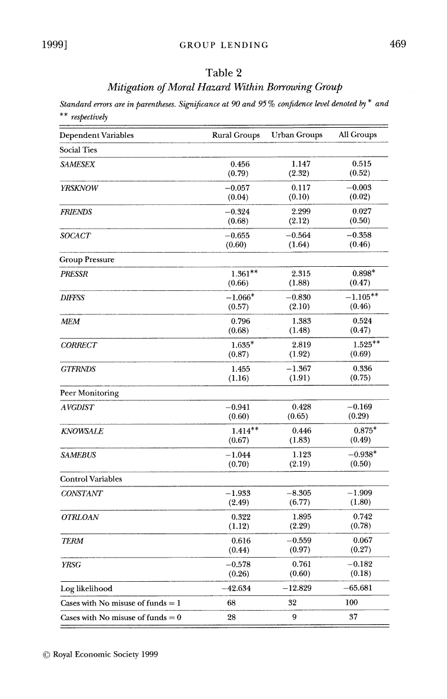

Slide 15
Left hand variable - members at least occasionally helping each other with loan repayments
Social ties still not that significant (except same gender variable)
Peer monitoring is most significant
  Knowledge of weekly sales and distance from each other are both highly significant in urban areas (90 and 95% levels)
  In rural areas average distance and same business are even more significant (98% level)

Slide 16
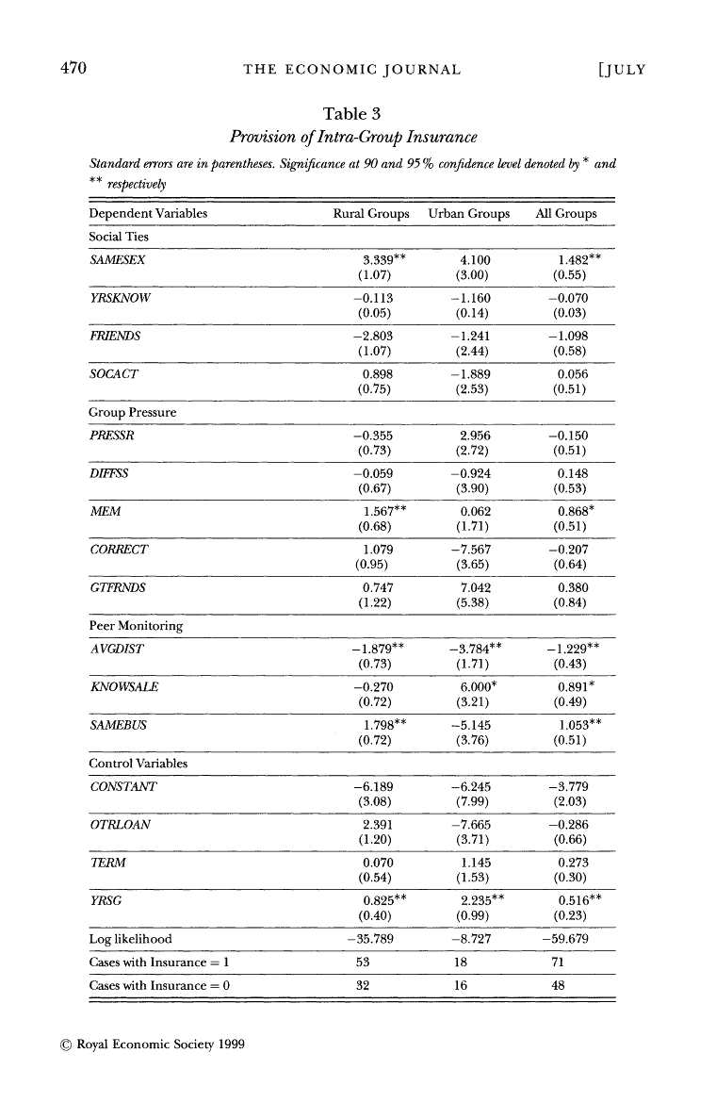

Slide 17
3rd Estimation – Loan Repayment
Left hand variable - based on FUNDAP designation of “problem free group” (not more than seven days late, average arrears < 3 days/loan)
Social ties mainly not significant
Peer monitoring again very important

Slide 18
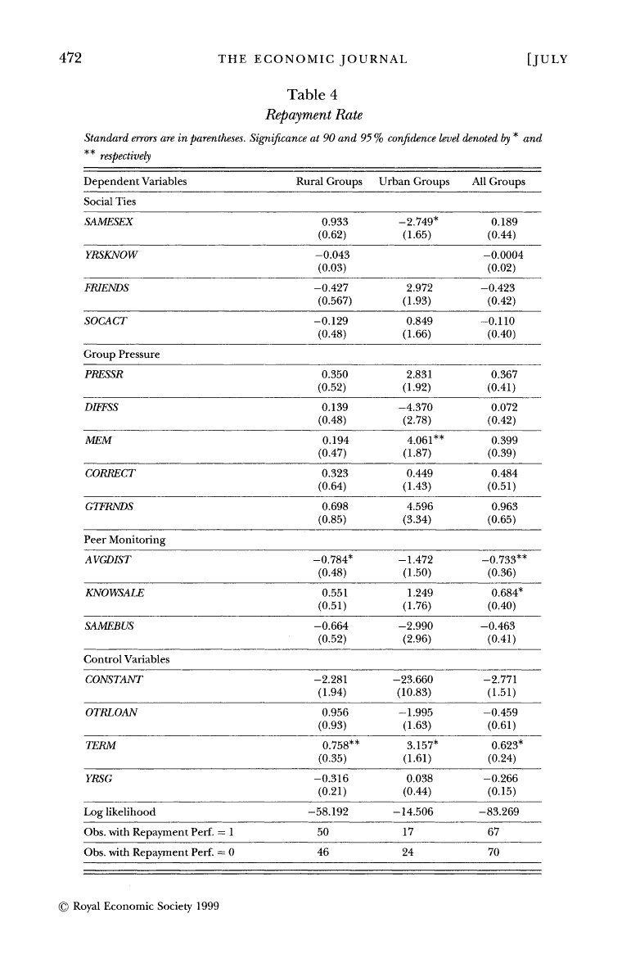

Slide 19
Overall Significance
Likelihood ratio tests based on previous 3 estimations
Suggest group lending success from peer monitoring and group pressure, rather than from past social ties

Slide 20
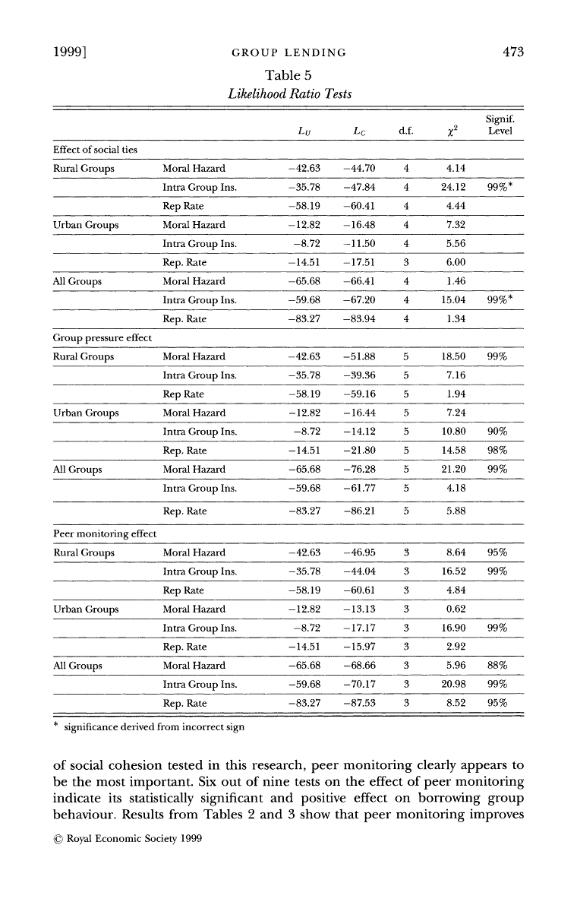

Slide 21
Policy Recommendations
Do not need to be implemented in area with strong social ties. Borrowing groups can function through a form of social cohesion that may operate independently of previously exiting social ties.
Conclusion, the performance of group is more likely influenced by the ability of borrowers monitoring one another and the ability to sack poor performers.
Importance of training sessions in which groups are advised to sack bad barrowers and to come to the aid of the ones who have been victim to unavoidable mishap.

Slide 22
Conclusions
Groups function as insurers (peer monitoring), but also have the authority to punish people (group pressure) → this authority is backed up by FUNDAP’s policies
With the above in mind, previous social ties are irrelevant
Urban and rural distinctions – peer monitoring more difficult in rural areas, so group pressure plays a larger role. The reverse applies in urban areas.
Group lending can work even when social ties aren’t particularly strong
Social cohesion does not necessarily imply past social ties

Slide 23
Critiques
Despite referencing the potential for size of loan/enterprise to affect repayment rate, Wydick never tests for this
Wydick does not test for any other factors that could potentially explain why group repayment is so high (small size of loan, Ghatak’s idea of self selection eliminating risky borrowers, etc.)
Gender: Female borrowers a small share of these

